Slide 1
Adverse Childhood Experiences: Increasing Level of Awareness and Perception of Preparedness when Working with Social Work Field Students
Marianne Benedek, LCSW
&
Alli Schuck, LSW

Slide 2

Agenda
Housekeeping
Survey (Pre-test)
Introductions
Adverse Childhood Experiences (ACEs) Overview
Nadine Burke Harris Video
ACEs and Social Work Field Students
ACEs Through a Fieldwork Lens
Tools
Survey (Post-test)
Questions

Slide 3

This Photo by Unknown author is licensed under CC BY-NC-ND.

Slide 4

Marianne Benedek, MSW, LCSW
Aurora University
Current Position
  Lecturer of Social Work
  Staff Therapist at a community mental health agency
  Doctoral student
Self-care strategies
  Running

Slide 5
Learning Objectives
Increase knowledge of adverse childhood experiences
Increase awareness of adverse childhood experiences when working with social work field students
Increase perception of preparedness when working with social work field students
Increase knowledge of utilizing a trauma-informed approach when working with social work field students
Identify resources for students and field instructors to address field-related trauma experiences, including vicarious and secondary trauma

Slide 6

Please tell us about yourself by posting the following information on the Padlet.
The link is provided in the Zoom chat.
Padlet
Name
Organization
Current Position
Self-care strategies
This Photo by Unknown Author is licensed under CC BY-SA-NC

Slide 7
What WILL I LEARN?
Overview of ACEs
ACEs & Social Work Students
Tools
Trauma-informed approach when working with students
Resources for students and field instructors

Slide 8

“What happens in childhood- like a child’s footprints in wet cement commonly lasts throughout life.
Time does not heal: time conceals”
-Vince Felitti

Slide 9
Original ACE Study
Published in 1998
Collaboration between the CDC and Kaiser Permanente
Examined how adverse childhood experiences impacted adult health/social effects throughout life

Slide 10
Original ACE Study
Over 17,000 participants from Kaiser Permanente’s San Diego Health Clinic completed a survey between 1995-1997
  Mean age: 56.1
  Sex: 52.1% women
  Race: 79.4% Caucasian
  Education: 43% College Graduates

Slide 11
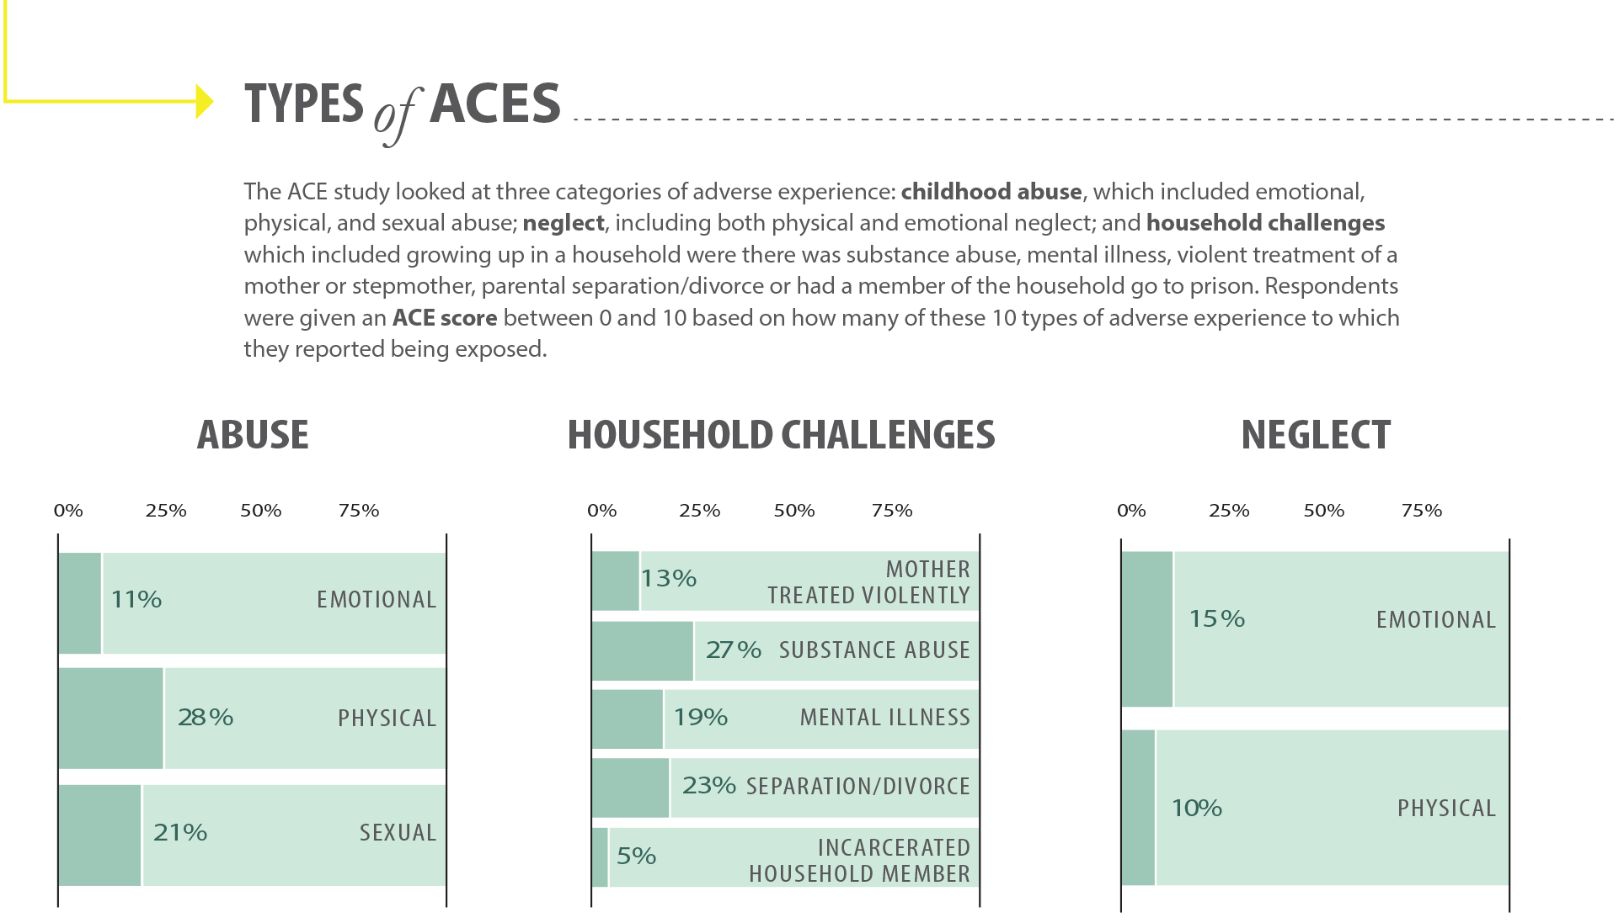

Slide 12
Findings
ACEs have a strong cumulative impact on adult health
As the number of ACES increases, the number of negative consequences increases
ACEs were linked to
Risky health behaviors
Chronic health conditions
Early death
> 4 ACEs
4-12 fold increase in health risks for alcoholism, drug abuse, depression and suicide attempts

Slide 13
Original ACE Study
Risk Factors
Smoking
Severe obesity
Physical inactivity
Depressed mood
Suicide attempts
Alcoholism
Drug abuse
Parental drug abuse
High lifetime number of sexual partners
History of STDs

Slide 14
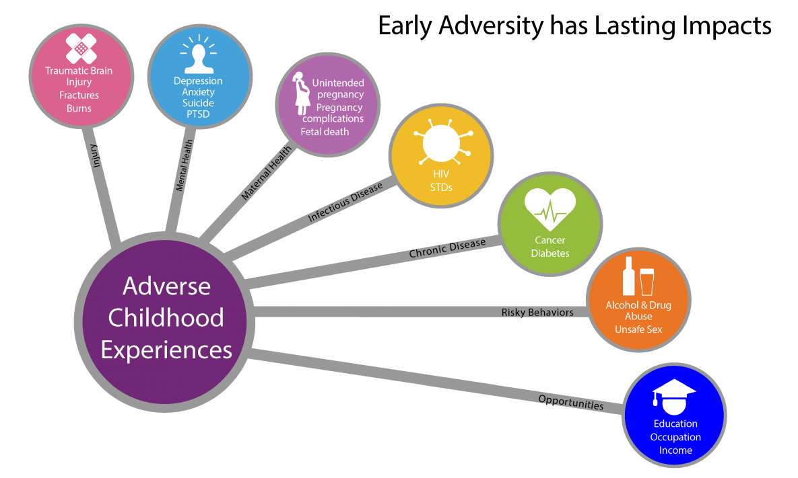
Notes:
Association Between ACEs and Negative Outcomes

Slide 15
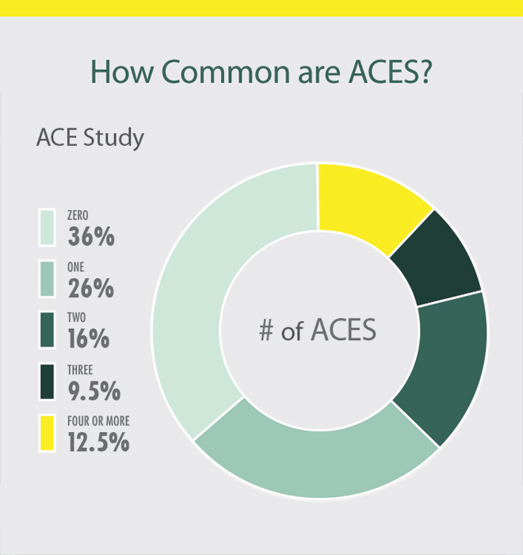

Slide 16

How childhood trauma affects health across a lifetime
Nadine Burke Harris TEDNadine Burke Harris TED

Slide 17
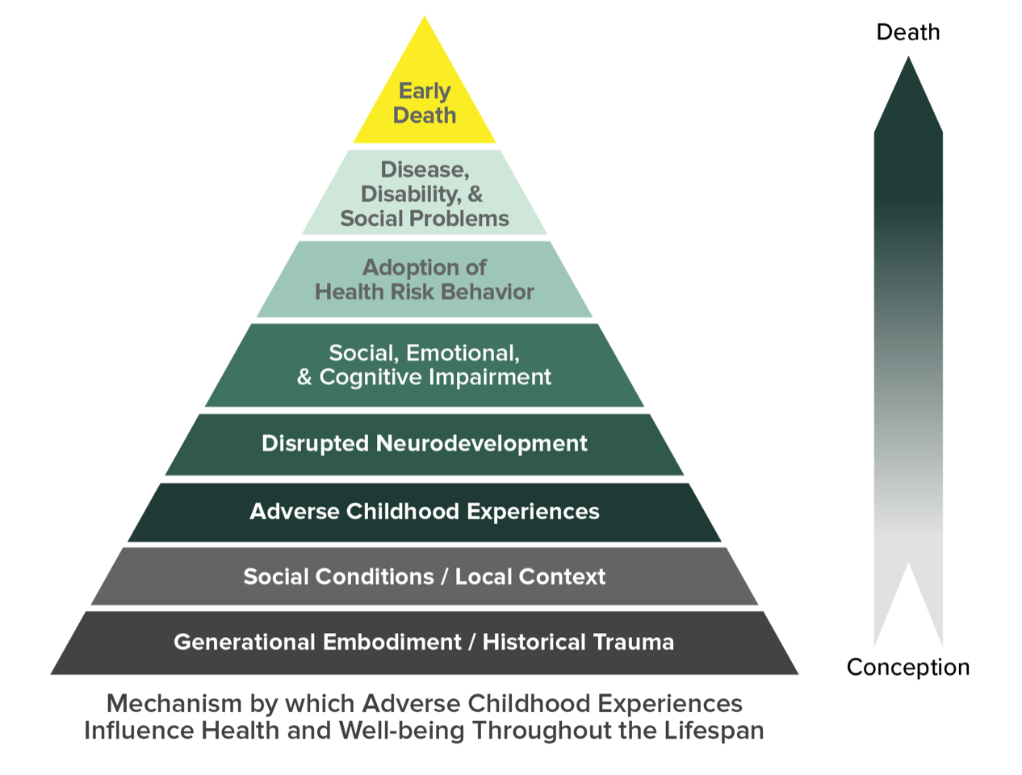
The ACE Pyramid

Slide 18
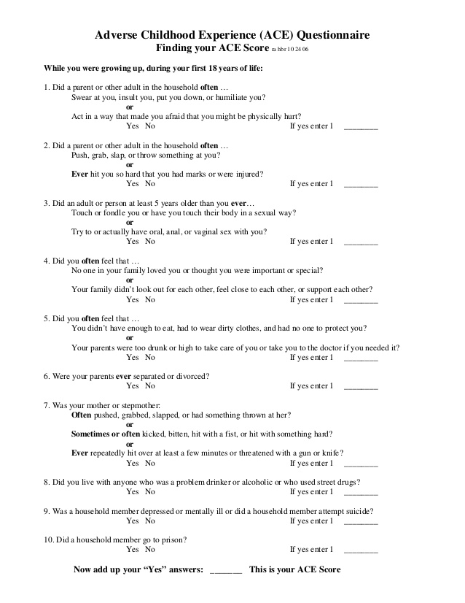
ACE questionnaire https://acestoohigh.com/got-your-ace-score/

Slide 19
EXPANDING THE ACE STUDY
OTHER EARLY LIFE EVENTS
  Racism
  Bullying
  Discrimination
  Community violence
  Housing instability
  Food insecurity
  Serious medical procedures of the child/caregiver
  Life-threatening illness of the child/caregiver
  Separation from caregiver via deportation or migration

Slide 20
Expanding the aCE study
New screening tools
CYW ACE Q
WHO ACE-IQ, & Pediatric ACE and other Determinants of Health Questionnaire

Slide 21

Aces are not a life sentence
Majority of individuals who experience trauma heal on their own
Caring relationships can help heal
Prevention and early intervention can reduce the impact of childhood trauma

Slide 22
“What is predictable is preventable”
- Robert Anda

Slide 23

BREAKOUT ROOM
In your groups, discuss
  How do you think ACEs impact your field students?
  Do you encourage your field students to complete screening and self-assessments?
  If so, which ones?
Share your findings on the Padlet labeled "Impact of ACEs on Field Students"
Impact of ACEs on Field Students Padlet

Slide 24
Adverse childhood experiences & social work students

Slide 25
Prevalence of Aces
&
Social work students
Thomas (2016) found
  > 79% of students in an MSW program had one ACE
  38% had 1-3
  42% of students had 4 or more
  25% had 6 or more
Gilin and Kaufman (2015) found
  78.3% of students had at least 1
  56.1% had at least 2
  27.3% of students had 4 or more
Notes:
Paragraph or bullets?

Slide 26
Aces
& msw students

Slide 27
Prevalence of Aces
&
Child Service providers
Esaki and Larkin Holloway (2013) investigated the prevalence of ACEs among child service providers
  70% had at least 1 ACE
  54% had at least 2 ACEs
  16% had 4 or more ACEs
Notes:
Paragraph or bullets?

Slide 28
Why does this matter?
Social Work Students have a high prevalence of ACEs
Practice from a trauma-informed approach and teach reflection, emotional regulation, self-care strategies, stress management
Reduce risk
Exposed to trauma related content in course and field work
Risk of retraumatization, secondary traumatic stress (STS), burnout, and vicarious traumatization (VT)

Slide 29
VT, STS, CF, BO & reTraumatization
Important to differentiate between related terms
Vicarious traumatization
Secondary traumatic stress
Compassion fatigue
Retraumatization
Burnout

Slide 30
Burnout
Exhaustion
Depersonalization
Reduced motivation and sense of achievement
Work-related emotional distress
Presents as
  Absenteeism
  Tardiness
  Underperformance

Slide 31
Retraumatization
Triggering or reactivation of trauma-related symptoms
Originating in earlier traumatic life events

Slide 32
Secondary traumatic Stress (STS)
Phenomenon which occurs when sharing traumatic experiences creates trauma related symptoms in the listener similar to the survivor
  Particularly when the listener is highly empathic or is trying to be highly empathic
Closely related to vicarious traumatization

Slide 33
Vicarious Trauma
Cumulative effect of working with individuals who have experienced trauma
Results from repeated exposure to empathically engaging with client's trauma-related material
  Including negative changes in therapist's
  View of self
  Identity
  Worldview
  Psychological needs
  Beliefs
  Memory
Only construct that specifically describes a cumulative, long-lasting impact on mental health professional's personal beliefs/ world view

Slide 34
Vicarious trauma (cont.)
Educators should be trained on signs of vicarious trauma and secondary traumatic stress
Students experiencing vicarious traumatization
Should be able to discuss it
Should get appropriate support so they can work with clients

Slide 35
Compassion fatigue
Originally referred to as secondary traumatic stress syndrome
Observed in caregivers/family members of trauma survivors
  Similar symptoms of PTSD
Considered less stigmatizing than STS
Defined as "empathic strain and general exhaustion" as a result of taking care of individuals in distress
Associated with helping professions
Involves empathic engagement and secondary trauma exposure
Not associated with cognitive disruptions

Slide 36
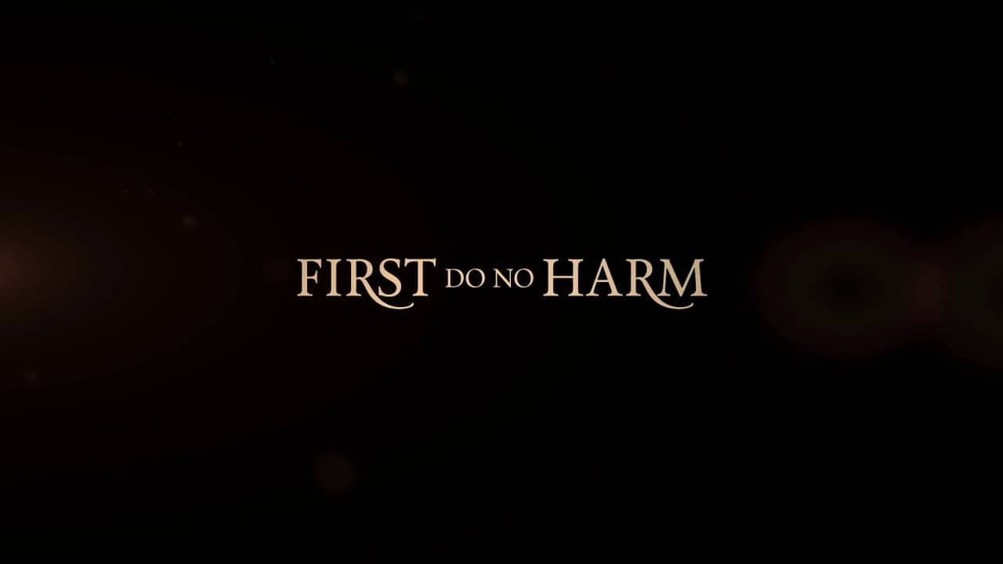
Teaching about trauma is not the same as trauma-informed teaching
Educators should “take the first step in adopting a trauma-informed approach" to teaching
This Photo by Unknown author is licensed under CC BY-NC-ND.

Slide 37
Exposure to Trauma Related Content During Course & fieldwork
Most students are exposed to trauma during course and/or fieldwork
May be the first time directly learning about and/or working with individuals who have encountered trauma.
Exposure can put students at a higher risk for secondary traumatic stress, burnout, and compassion fatigue.
  History of early adversity also puts social work students at a greater risk
Important that schools of social work and field instructors are aware of ACES, the prevalence of ACEs in their students, and utilize a trauma-informed approach to education/training

Slide 38
EXPOSURE TO TRAUMA RELATED CONTENT
DURING COURSE & FIELDWORK (cont.)
Butler et al. (2016)
Explored how trauma-related content and stress, and self-care, impact students in mental health training programs.
Clinical training has the potential to put students at risk
  Students without trauma training may not understand their reactions when working with clients experiencing trauma
All students reported being exposed to trauma during field and/or coursework
  Some reported feeling retraumatized
  Experienced STS symptoms similar to those in mental health professions
All students experienced at least 1 of 5 potential trauma exposures during their program.

Slide 39
EXPOSURE TO TRAUMA RELATED CONTENT DURING COURSE & FIELDWORK (cont.)
Butler et al. (2016)
Concluded that graduate work including trauma “can involve secondary exposures” in field and coursework
Students reported coursework as reactivating as fieldwork.
Explored potential trauma exposures, risk factors, and protective factors encountered by students during their clinical training
  Risk factors: trauma exposure and perception of stress in fieldwork
  Protective factors: self-care

Slide 40
EXPOSURE TO TRAUMA RELATED CONTENT
DURING COURSE & FIELDWORK (cont.)
Study by Courtois and Gold
25% of students in a clinical and counseling psychology program worked with clients without trauma training
  Students are put into a role similar to that of a client
  Advocate for a trauma-informed approach to clinical training

Slide 41
EXPOSURE TO TRAUMA RELATED CONTENT
DURING COURSE & FIELDWORK (cont.)
Butler et al. (2018)
Explored the influence of ACEs on student’s developing STS symptoms during course and/or fieldwork.
Association between students with higher ACE scores and a greater likelihood that students would experience trauma related training (TRT) and STS symptoms during their program.
Concluded students with a history of early adversity were at a greater risk for TRT
Need for a trauma-informed approach

Slide 42
EXPOSURE TO TRAUMA RELATED CONTENT
DURING COURSE & FIELDWORK (cont.)
Butler et al. (2018)
Trauma-informed approach would
Acknowledge the prevalence of and impact of ACEs on social work students
  Help create and implement strategies to address and possibly minimize the impact of trauma-related exposure during course/fieldwork
  Potential to enrich student resilience which could be helpful throughout career

Slide 43
BREAKOUT ROOM
In your groups, discuss
What do you think the field instructor's role is around helping students be successful as it relates to their trauma experiences?
Share your findings on the Padlet labeled "Field instructor's Role"
Field Instructor's Role Padlet

Slide 44

This Photo by Unknown Author is licensed under CC BY-SA-NC

Slide 45

Social Work is a Personal Profession
What made you choose this career path?

Slide 46
Social work can be traumatic
Social workers are often exposed to situations that may traumatize or retraumatize them due to the nature of their work
Social workers have significant responsibility in their roles for the well-being of others, resulting in more intense experiences when mistakes are made
Students can be more vulnerable to these elements due to lack of experience, still- developing professional identities, and power differentials

Slide 47
3's of trauma: Event, experience and effects
Event: events or circumstances may include the actual or extreme threat of physical or psychological harm, or severe or life-threatening neglect that imperils healthy development
Experience of Event: how an individual labels, assigns meaning to, and is disrupted by an event
Adverse Effects: can be short or long term effects, and may or may not be realized by the individual

Slide 48


Slide 49
Trauma-informed supervision
Brave Space vs. Safe Space
  - Set the stage from day one
  - Acknowledge the power differential
  - Give permission to make mistakes
Develop Your Agreements
  - Collaborate to develop agreements on how to engage when things get difficult BEFORE things get difficult
  - The Equity Lab Agreements*
    Stay engaged
    Speak your truth
    Experience discomfort
    Grace with others, grace with ourselves
    Observe the 24- to 48-hour rule
    Notice patterns of participation
    Respect confidentiality
    Recognize intent vs. Impact
    Consider power dynamics
    Recognize the danger of a single story

Slide 50
4 r's of Trauma Informed Care
Realize
Recognize
Respond
Resist
the widespread impact of trauma and understands potential paths for recovery
signs and symptoms of trauma in clients and staff
by fully integrating knowledge about trauma into policies, procedures, and practices
re-traumatization by actively addressing risks

Slide 51
6 Principles to a trauma-informed approach
Safety
Trustworthiness & transparency
Peer support
Collaboration & mutuality
Empowerment & choice
Cultural, historical & gender issues

Slide 52

What can we do?
What can social work educators do to help social work students be successful?

Slide 53

tools
Thomas (2016) suggested educators
  Take a closer look at resiliency
  Provide an environment that can help students process triggers
  Teach
    Reflection
    Emotional regulation
    Self-care strategies
    Stress management in the curriculum
Important to build resilience to prevent future STS, traumatization and burnout.

Slide 54
tools
  Provide space for students to explore personal attributes
  Foster increased peer support and reflective supervision opportunities
  Develop coping strategies regarding self-care and the maintenance of work-life balance
  Be explicit in teaching about resilience
  Increase faculty and field instructor modeling of cultural awareness and leadership development to build resilience

Slide 55
tools
Important for educators to understand resilience to better prepare students for their careers.
  Students can be taught resilience
  Explicitly focus on how to make them resilient practitioners

Slide 56
tools
Thomas and Beecher (2018) claim
Teach students about exposure and effects of trauma
Help students understand what to do regarding traumatic and stressful experiences
Create learning experiences that help students become more aware of challenging emotional responses
Provide information about difficulties with avoidant coping
Provide information about “ethics of addressing issues that might impair future professional functioning”

Slide 57
tools
Thomas and Beecher (2018)
Assist students with strategies for managing experience
Provide opportunities for reflection when encountering challenging and/or triggering experiences
Proactively develop and rehearse mindfulness and acceptance skills
Provide coursework/fieldwork that support students to acknowledge and reflect on difficult experiences, as well as accept and cope with them
Inform students about supportive services such as university counseling centers
  AU Counseling Center for AU Students

Slide 58
13 teaching strategies to minimize the risk of Vicarious Trauma
Teach about vicarious trauma and vicarious resilience
    Vicarious resilience: "positive meaning-making, growth, and transformation in the therapist's experience resulting from exposure to client's resilience (Hernadez et al. 2010, as cited in Gilin and Kaufman, 2015, p. 391)
Teach signs and symptoms of vicarious trauma
    Teach factors believed to increase vulnerability
      Personal history
      Client factors
      Organizational dynamics
Provide psychoeducation to students- content may be distressing
Teach self-care
    Small groups where students set self-care goals
    Report on progress or challenges to meet goals

Slide 59
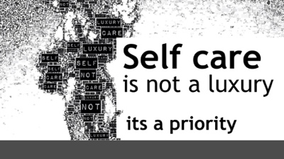
This Photo by Unknown Author is licensed under CC BY-NC-ND

Slide 60
Self-Evaluation of STS, VT, SELF-CARE, and Shared Trauma
Council for Social work Education (CSWE) includes in their Specialized Practice Curricular Guide for Trauma-Informed Social Work Practice
Goals
  In-class activity teaching students about STS, VT, and shared trauma
  Identify and engage in evidence-based strategies for self-care to promote resilience
  Self-evaluate their own level of STS using various self-assessment measures
Students assess
  Level of STS
  Vicarious trauma
  Personal and professional self-care practices
Students identify
  Self-care plan to intentionally use self-care strategies

Slide 61
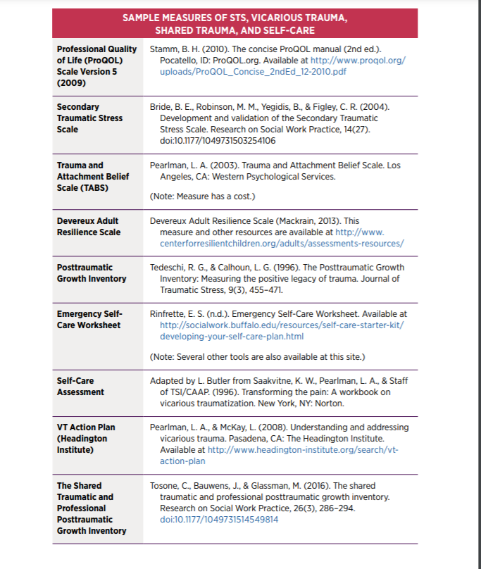
Self-Evaluation of STS, VT, SELF-CARE, and Shared Trauma

Slide 62
Developing your self-care plan
(Lisa butler- University at buffalo)
How do you cope now?
What do you do for self-care now?
Maintenance self-care: Adding self-care practices/eliminating obstacles
Emergency Self-Care
Make a commitment to yourself
Share your plan
Follow your plan

Slide 63
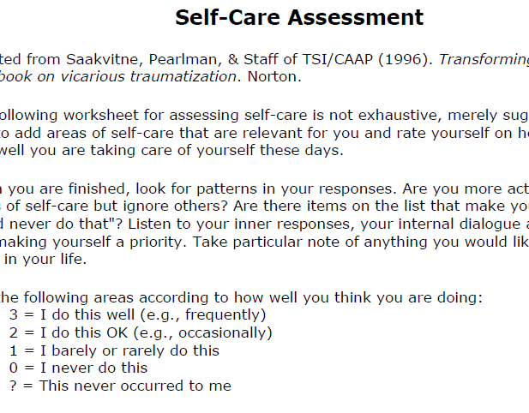
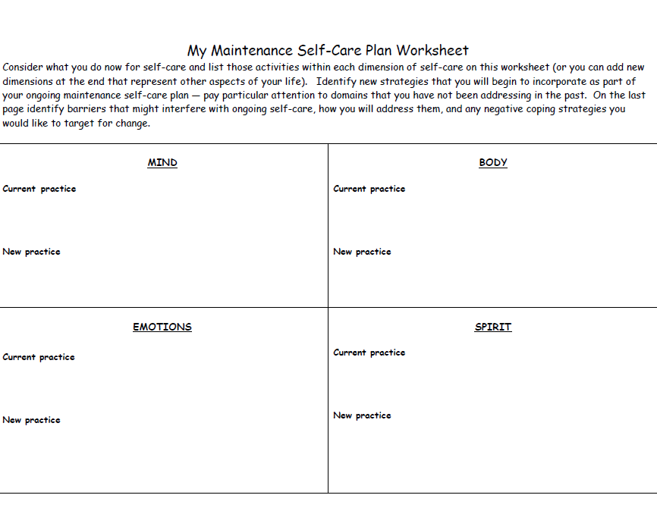
Self-Care Assessment &
Plan

Slide 64

emergency self-care worksheet
Difficult to think what we should do when things are difficult
Have a plan
3 things to consider
What to do
What to think
What to avoid

Slide 65

13 teaching strategies to minimize the risk of Vicarious Trauma
Teach self-regulation
  Deep breathing
  Guided imagery
  Mindfulness
This Photo by Unknown author is licensed under CC BY-NC-ND.

Slide 66

Teach self-regulation
  Deep breathing
    Therapist Aid video How to do Deep Breathing
  Guided imagery
  Mindfulness
    Apps such as Calm, Headspace, Insight Timer
  Guided Meditation
    Leaves on a Stream

Slide 67
13 teaching strategies to minimize the risk of Vicarious Trauma
Be mindful when showing videos that focus on trauma
      Provide information in advance
      Leave the lights on
      Allow students permission to leave
Teach students the benefits of understanding a theoretical framework about trauma
    Buffer against feeling overwhelmed and powerless
    Knowledge can help manage distressing emotional/physical reactions
Provide time for students to share their understanding of existential questions such as why some abuse

Slide 68
13 teaching strategies to minimize the risk of VT (cont.)
Encourage students to use logs and journals to record their reactions
    Increase self-awareness
    Record self-care strategies.
    Don't expect students to share
Teach students about potential for post traumatic growth
    Increased appreciation for life
    Meaningful interpersonal relationships
    Personal strength
    Shift in priorities

Slide 69
13 teaching strategies to minimize the risk of VT (cont.)
Provide an expanded definition of empathy
    Empathy does not require visualization of client experiences
    Could be harmful
Teach students to look at micro and macro solutions
    Transform negative experiences into meaningful action
    Advocacy, policy, laws, research
Integrate courses such as practice, policy and research to prevent lasting effects of trauma

Slide 70

Social work students tend to have higher rates of early adversity
Impact of vicarious trauma, secondary traumatic stress, retraumatization, burnout
Importance of psychoeducation
Self-care
  Teach and provide resources
Self-regulation
  Teach and provide resources
Encourage students to use journals and/or logs
Continue to educate ourselves about the impact of ACEs, vicarious trauma, and other training related trauma
This Photo by Unknown Author is licensed under CC BY-NC-ND

Slide 71
Thoughts?

Slide 72

Counseling resources
The Ecker Center for Mental Health- 847-695-0484
www.eckercenter.org
Family Counseling Service of Aurora- 630-844-2662
www.aurorafcs.org
Greater Elgin Family Care Center- 847-608-1344
http://gefcc.org/
TriCity Family Services- 630-232-1070
www.tricityfamilyservices.org

Slide 73
Counseling resources for AU Students
AU Counseling and Psychological Services (Students) - 630-844-4932
https://aurora.edu/student-life/campus-services/counseling/index.html

Slide 74

QUESTIONS
This Photo by Unknown Author is licensed under CC BY-SA

Slide 75


Slide 76
Contact information
Marianne Benedek Mbenedek@aurora.edu
Alli Schuck Aschuck@aurora.edu

Slide 77
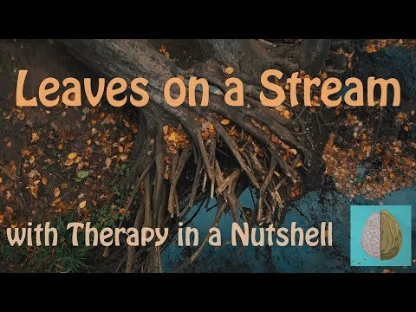

Slide 78
References (cont.)
ACES Too High. Got your ACE score? Retrieved from https://acestoohigh.com/got-your-ace-score/
Butler, L.D., Carello, J. & Maguin, E. (2016). Trauma, stress and self-care in clinical training: Predictors of burnout, decline in health status, secondary traumatic stress symptoms, and compassion satisfaction. Psychological Trauma Theory, Research, Practice, and Policy.
Butler, L.D., Maguin, E., & Carello, J. (2018). Retraumatization mediates the effect of Adverse Childhood Experiences on clinical training-related secondary traumatic stress symptoms. Journal of Trauma and Dissociation, 19(1), 25-38.
Norton, R. (2006, November 4). How to train a cat to operate a light switch [Video file]. YouTube. http://www.youtube.com/watch?v=Vja83KLQXZs
Burke Harris, N. (2014). How childhood trauma affects health across a lifetime. [Video]. Ted Conferences. Retrieved from https://www.ted.com/talks/nadine_burke_harris_how_childhood_trauma_affects_health_across_a_lifetime
Carello, J. & Butler, L. (2014). Potentially Perilous Pedagogies: Teaching Trauma is not the same as trauma-informed teaching. Journal of Trauma & Dissociation, 15(153-168).
Centers for Disease Control and Prevention. (2020). Adverse Childhood Experiences Resources. Retrieved from https://www.cdc.gov/violenceprevention/aces/resources.html?CDC_AA_refVal=https%3A%2F%2Fwww.cdc.gov%2Fviolenceprevention%2Facestudy%2Fresources.html
Council on Social Work Education. (2015). Specialized Practice Curricular Guide for Trauma-Informed Social Work Practice. Retrieved from https://www.cswe.org/getattachment/education-resources/2015-curricular-guides/2015epas_traumainformedsw_final-web.pdf

Slide 79
References
Felitti VJ, Anda RF, Nordenberg D, Williamson DF, Spitz AM, Edwards V, Koss MP, & Marks JS. (1998). Relationship of childhood abuse and household dysfunction to many of the leading causes of death in adults: the adverse childhood experiences (ACE) study. American Journal of Preventative Medicine, 14, 245–258.
Felitti VJ, (2009). Adverse Childhood Experiences and adult health. Academic Pediatrics, 9, 131-132.
Gilin, B. & Kauffman, S. (2015). Strategies for teaching about trauma to graduate social work students. Journal of Teaching in Social Work, 35, 378-396.
Koita, K., Long, D., Hessler, D., Benson, M., Daley, K., Bucci, M., Thakur, N. & Burke Harris, N. (2018). Development and implementation of a pediatric adverse childhood experiences (ACEs) and other determinants of health questionnaire in the pediatric medical home: A pilot study. PLos One, 13(12), 1-16.
Thomas, J.T. & Beecher, B. (2019). What doesn’t kill you. Advances in Social Work, 18(4), 1113–1134. https://doi.org/10.18060/21589
Thomas, J.T. (2016). Adverse Childhood Experiences Among MSW Students. Journal of Teaching in Social Work, 36(3), 235-255, DOI: 10.1080/08841233.2016.1182609
Quitangon, G. (2019). Vicarious trauma in clinicians: Fostering resiliency and preventing burnout. Psychiatric Times, (36)7.
University at Buffalo. (n.d.). Developing your self-care plan. Retrieved from http://socialwork.buffalo.edu/resources/self-care-starter-kit/developing-your-self-care-plan.html

