Slide 1
REFLECTIVE SUPERVISION WITH FIELD STUDENTS
Hosted By:
Alli Schuck, MSW, LSW
Alexis Trocki, AM, LCSW,
Ariana Carlson Maggio, MSW, LCSW, PEL
Kim Milton, LCSW, CADC

Slide 2
GROUP AGREEMENTS
Break-out Rooms: Camera on, Microphone on
Maintain participant privacy.
Be mindful of your airtime.
Other Agreements?

Slide 3
Presentation Objectives
01
02
03
DEFINE REFLECTIVE SUPERVISION.
UNDERSTAND ITS IMPORTANCE IN THE ROLE OF FIELD EDUCATION AND DEVELOPING EMERGING SOCIAL WORKERS.
IDENTIFY 1-2 WAYS YOU CAN INCORPORATE REFLECTIVE SUPERVISION INTO YOUR SOCIAL WORK PRACTICE.

Slide 4
BREAKOUT GROUP INTRODUCTIONS

Slide 5
CASE STUDY #1

Slide 6
CASE STUDY #2

Slide 7
Case Study Questions
How would you approach each situation?
What was your initial reaction when reading these scenarios?

Slide 8
DEFINE REFLECTIVE SUPERVISION
Objective #1

Slide 9
WORD CLOUD ACTIVITY

Slide 10
Characteristics of Reflective Supervision
Consistent
Private
Mutual
Collaborative
Reflective
Relational
Notes:
Citation: https://www.icmhp.org/wp-content/uploads/2020/03/Reflective-Practice-Guide.pdf

Slide 11
Traditional vs. Reflective Supervision
Traditional Supervision
Reflective supervision
Directive
Role = teacher/manager
No/little self-disclosure
Focus on case content
Performance focused
Non-directive
Role = relational
Self-disclosure used to explore responses to the work
Focus on how the practitioner is responding to the work
Relationship focused
Building student capacity to navigate complexity

Slide 12
COMPLETE THE SELF-REFLECTION TOOL ON YOUR OWN
Notes:
To view the self-reflection tool on your own, follow the link, and scroll to Pg. 22
https://www.icmhp.org/wp-content/uploads/2020/03/Reflective-Practice-Guide.pdf

Slide 13
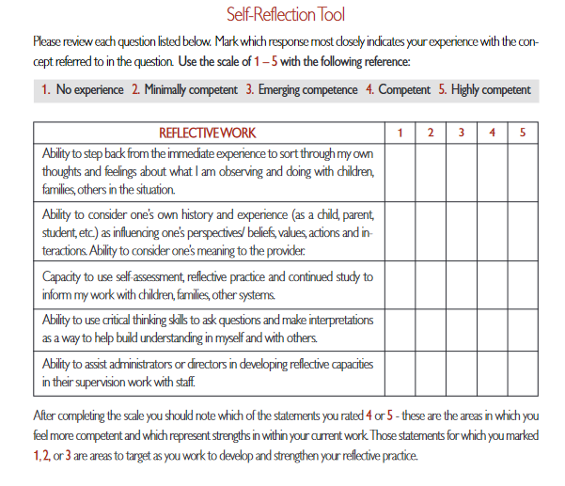
https://www.icmhp.org/wp-content/uploads/2020/03/Reflective-Practice-Guide.pdf
Notes:
What do you notice about this questionnaire?
What came up for you as you read these statements?
Are there any statements that are particularly poignant to you?
https://www.icmhp.org/wp-content/uploads/2020/03/Reflective-Practice-Guide.pdf
Pg. 22

Slide 14
"ONE MUST BE WILLING TO ENGAGE WITH AND WONDER ABOUT THEIR OWN THOUGHTS AND FEELINGS IN ORDER TO UNDERSTAND THE THOUGHTS AND FEELINGS OF ANOTHER"

Slide 15
BREAKOUT GROUP
Notes:
Reflect on a previous supervisor you’ve had that helped you grow in your social work practice. What was it about that supervisor that was helpful? How did they support your growth?
Reflect on a previous supervisor you have had that did not support your growth, or in fact, inhibited your growth in your social work practice. What was it about that supervisor that was not helpful? In what ways, did they make it difficult for your development and growth as a social worker?

Slide 16
BREAK

Slide 17
UNDERSTAND ITS IMPORTANCE IN THE ROLE OF FIELD EDUCATION AND DEVELOPING EMERGING SOCIAL WORKERS
Objective #2

Slide 18
SURVIVE TO THRIVE

Slide 19
PADLET ACTIVITY
Notes:
AWhat does it mean for a student to “survive” an internship? What has to happen for this to occur?
Shorter term focus
What does it mean for a student to “thrive” in an internship? What has to happen for this to occur?
Long term
What does it mean to “survive” having an intern? What does it mean to “thrive” having an intern? What has to be in place for this to occur?

Slide 20
MASLOW'S HIERARCHY IN FIELD

Slide 21
Reflection
Connection
Completing Hours, Tasks, Technology

Slide 22
Fostering Student Learning
Less autonomous to more autonomous
Self-efficacy
Experiential learning theory
Flexibility: Openness new ideas
Student resilience
Wright, 2018
Bogo, 2017​

Slide 23
Reflection & Professional Competency
Council on Social Work Education (CSWE) Competencies
Reflective practice
Relational & Reflective Capacity

Slide 24
Reflective Competencies
Contemplation
Curiosity
Self-awareness
Professional/personal development
Emotional Response
Parallel Process

Slide 25
Parallel Process
Reflection of practice relationship
Model relational space
Hold space for curiosity, reflection & exploration
Thus allowing intern to do so in practice
Consider who holds this space for you?
Client-Intern
Supervisor-________
Intern-Supervisor

Slide 26
Implicit Bias
Reflective practice & supervision
Increased/ongoing awareness
Anti-racist & anti-oppressive social work practice
Identifying assumptions
Modeling exploration & reflective stance
Method for application of cultural humility

Slide 27
"A PARTNERSHIP FORMED FOR LEARNING AND FOR DEVELOPING A DEEPER AWARENESS ABOUT ALL ASPECTS OF A CLINICAL CASE, ESPECIALLY THE SOCIAL, EMOTIONAL, AND OVERALL INTERRELATED COMPLEXITY OF DEVELOPMENTAL DOMAINS." SHAHMOON-SHANOK 2006, P. 344

Slide 28
Characteristics of Reflective Supervisors
Attentive
Engaged
Thoughtful
Self-aware
Curious
Tomlin et al. 2014, as cited in Shea, 2018
Notes:
https://www.icmhp.org/wp-content/uploads/2020/03/Reflective-Practice-Guide.pdf

Slide 29
What does a reflective supervisory relationship look like?
Collaborative
Follows the supervisee's lead
Non-directive
Explores supervisee's emotional response to the work
Recognizing a power differential
No "right answer"
Focused on critical thinking
Empowering students to explore their "compass" to working with difficult and nuanced situations
Notes:
Ariana

Slide 30
DEVELOPING A COMPASS
Shon, 1983, Bogo 2015; Hendricks et al. 2013 as cited in Shea, 2019

Slide 31
Potential Field Outcomes
Longevity of placement
Efficacy
Increased capacity for independent problem solving
Contribution to life-long learning

Slide 32
BREAK

Slide 33
IDENTIFY 1-2 WAYS YOU CAN INCORPORATE REFLECTIVE SUPERVISION INTO YOUR SOCIAL WORK PRACTICE
Objective #3

Slide 34
REFLECTIVE LEARNING IS AN HOLISTIC, CREATIVE AND ARTISTIC PHENOMENON WHICH ENDEAVORS TO HOLD THEORY AND PRACTICE TOGETHER IN A CREATIVE TENSION. IT ALSO ALLOWS FOR UNCERTAINTY AND MISTAKES AND ACKNOWLEDGES THE COMPLEXITY, DIVERSITY AND EMOTIONALITY OF SITUATION OFFERS MORE SCOPE FOR STUDENT PRACTITIONERS TO REACH INFORMED DECISIONS WHICH, BY EMBRACING THE BREADTH OF KNOWLEDGES WHICH INFLUENCE DECISIONS, COULD HELP AVOID DEFENSIVE, ROUTINISED AND RITUALISTIC RESPONSES.

Slide 35
"GILKERSON (2004) SUGGESTS THAT WHEN ENGAGED IN REFLECTIVE PRACTICE, ONE MUST ASK, “WHAT DID YOU DO AND MOST IMPORTANTLY, HOW DID YOU FEEL ABOUT WHAT YOU DID?”

Slide 36
Strategies to Utilize Reflective Supervision
Ensure consistent supervision opportunities
Take a collaborative stance; fight the need to "be the expert"
Prioritize open-ended questions with your students
Ask the student to share ideas: What are your thoughts about that? How do you think you can approach this?
Ask students about their emotional response to the work: How did that feel when you experienced this? How do you think the client felt during that encounter?
Explore accountability aspects: What is getting in the way of your work?

Slide 37
BREAKOUT GROUP
Notes:
Questions to reflect on in your breakout groups:
What barriers may exist for you to provide reflective supervision?
What do you do in your current practice that enhances reflective competencies of your students?
How do you feel about what you are doing in your supervision?
How comfortable do you feel with "non-directive" supervision?

Slide 38
What barriers may exist for you to provide reflective supervision?
What do you do in your current practice that enhances reflective competencies of your students?
How do you feel about what you are doing in your supervision? How comfortable do you feel with "non-directive" supervision?

Slide 39
Potential Barriers to Utilizing Reflective Supervision
Student readiness for reflective capacity
Student needing more directive supervision
Supervisor readiness and education
Agency contexts

Slide 40
CASE STUDY #1 REVISIT

Slide 41
CASE STUDY #2 REVISIT

Slide 42
BREAKOUT GROUP CASE STUDY
Notes:
Case Study Questions
Reflect back on your initial reaction to these scenarios. How can you use the knowledge of your emotional reaction to determine how to best support this student and the field placement?
In reflecting on today's discussion, what would you do differently in your approach with the student?
What elements of your apporach foster a reflective stance? What would you need to support a reflective stance ?

Slide 43
Case Study Questions
Reflect back on your initial reaction to these scenarios. How can you use the knowledge of your emotional reaction to determine how to best support this student and the field placement?
In reflecting on today's discussion, what would you do differently in your approach with the student?
What elements of your apporach foster a reflective stance? What would you need to support a reflective stance ?

Slide 44
REVISIT THE WORD CLOUD ACTIVITY

Slide 45
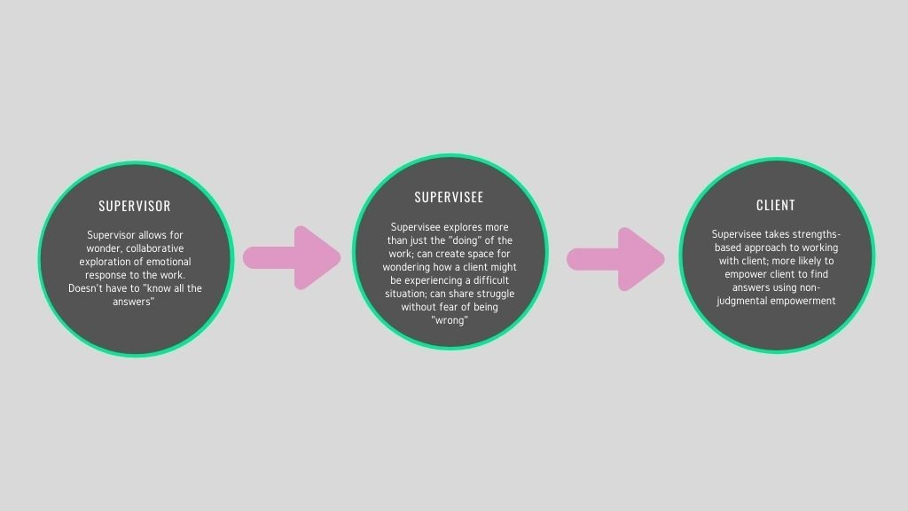

Slide 46
Resources and References
Bogo, Z. (2017). Best practices in social work field education: from global to local.
Council on Social Work Education. (2015a). Educational policy and accreditation standards. Retrieved from https://www.cswe.org/getattachment/Accreditation/Accreditation-Process/2015-EPAS/2015EPAS_Web_FINAL.pdf.aspx
Davys, A., & Beddoe, L. (2009). The Reflective Learning Model: Supervision of Social Work Students. Social Work Education, 28(8), 919–933. https://doi.org/10.1080/02615470902748662
Franklin, L. (2011). Reflective Supervision for the Green Social Worker: Practical Applications for Supervisors. The Clinical Supervisor, 30(2), 204–214. https://doi.org/10.1080/07325223.2011.607743
Shea, S. (2019). Reflective Supervision for Social Work Field Instructors: Lessons Learned from Infant Mental Health. Clinical Social Work Journal, 47(1), 61–71. https://doi.org/10.1007/s10615-018-0677-2
Tomlin, A., Weatherston, D., & Pavkov, T. (2014). CRITICAL COMPONENTS OF REFLECTIVE SUPERVISION: RESPONSES FROM EXPERT SUPERVISORS IN THE FIELD: Critical Components of Reflective Supervision. Infant Mental Health Journal, 35(1), 70–80. https://doi.org/10.1002/imhj.21420
Wayne, J., Bogo, M., & Raskin, M. (2010). Field education as the signature pedagogy of social work education: Congruence and disparity. Journal of Social Work Education, 46(3), 327-339.
Wring, D. (2018, October). From Good to Great: An Innovative Bridge Program Developing Professionalism and Self-Reflection in Social Work Students Entering the Field : The Field Educator. Field Educator Journal. https://fieldeducator.simmons.edu/article/from-good-to-great-an-innovative-bridge-program-developing-professionalism-and-self-reflection-in-social-work-students-entering-the-field/
https://www.mhc.wa.gov.au/media/2641/mental-health-network-sub-network-pe-anded-report-clinical-reflect.pdf
https://www.icmhp.org/wp-content/uploads/2020/03/Reflective-Practice-Guide.pdf
https://link.springer.com/article/10.1007/s10615-018-0677-2

